Slide 1
Deceptive Reinforcement Learning
Integrating Multiple Rewards in Sing Q-Table
Supervisor: Tim Miller
Group Members:
Yingnan Shi, Junchao Wang,Qingfeng Xu

Slide 2
Content
Background
Project Introduction
Methods
Evaluation
Conclusion
Notes:
Here are the content that we will talk about in our presentation. Firstly, we will introduce the background knowledge about our project, including what is reinforcement learning and what is deceptive reinforcement learning. Secondly, we will introduce our project, integrating multiple rewards in single Q-table. After that, we will discuss two solutions, the one is rewarding shaping, another is entropy method. Then, we will show the evaluation results by comparing with baseline and previews work. At last, there will be a brief conclusion.

Slide 3
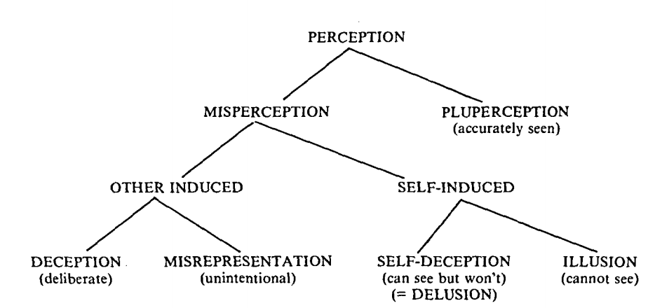
What is deception?
Notes:
In 1982, Whaley proposed that deception is a kind of perception. The important points is that it is a other induced misperception with true representation.
A deceiver intending and attempting to induce deception, contrives and projects a false picture of reality(Whaley, 1982).

Slide 4
Why deception?
Path A
Path B
Notes:
Deception, can be a useful tool in national Defense, games, cybersecurity and etc. For example, there are several potential targets and our army is going to attack one of those. The enemy is able to observer our army by satellite and we want them to realize what is exactly the real goal of us until the last moment. How can we plan the path?

Slide 5
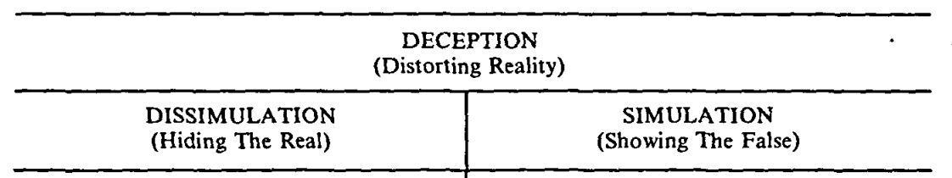
Our Deception Method
Notes:
There are two kinds of deception methods, we focus on dissimulation, which means we only hide part of real information to decept others, rather that showing the false result to them.

Slide 6
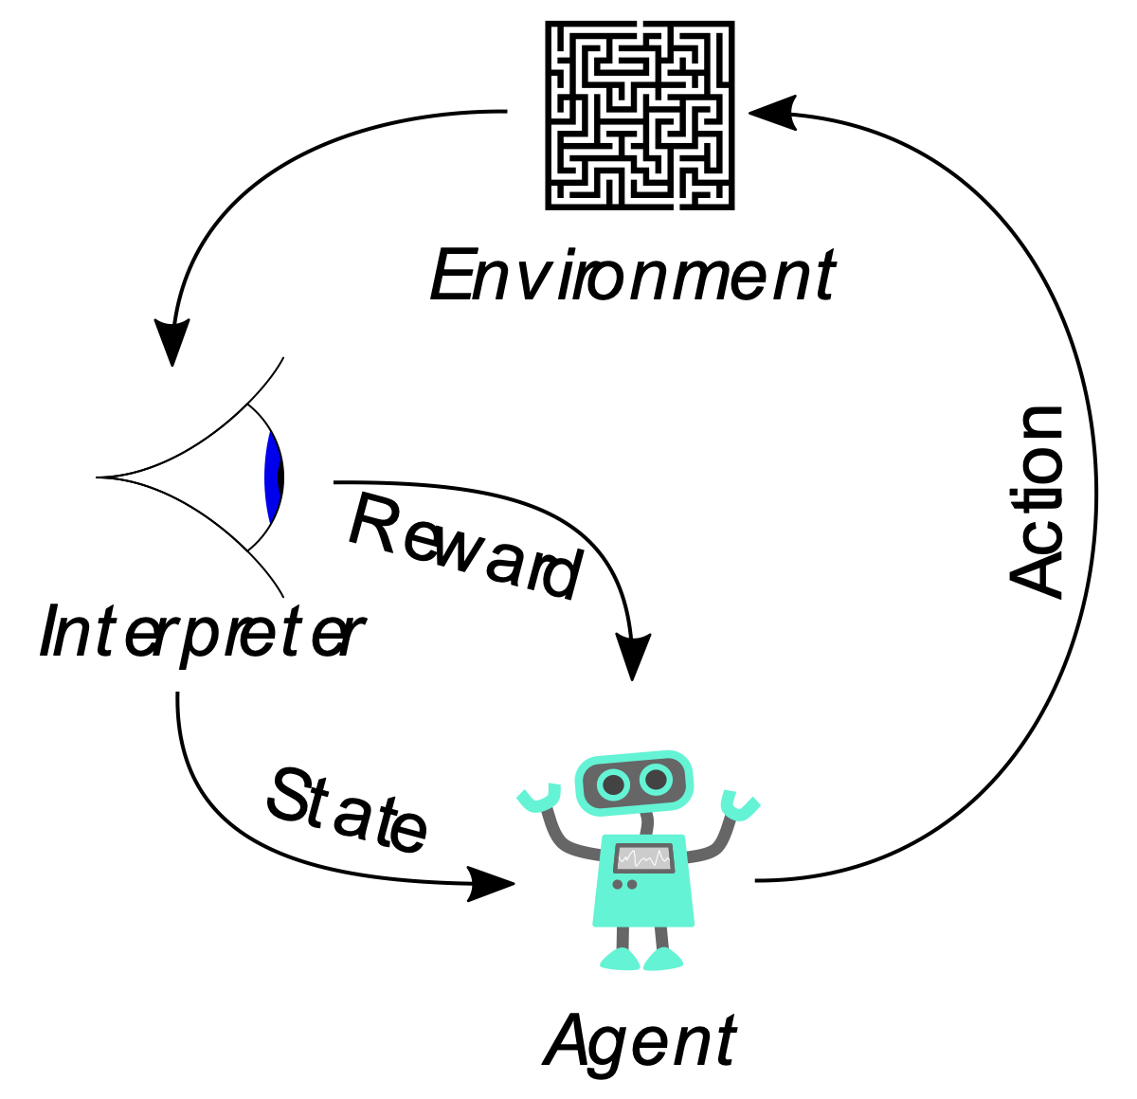
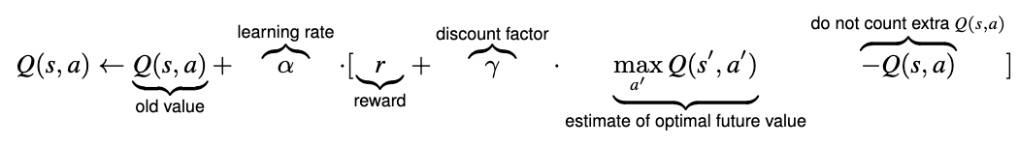
What is Reinforcement Learning?
Notes:
Reinforcement learning (RL) is an area of machine learning concerned with how software agents ought to take actions in an environment in order to maximize the notion of cumulative reward.
The typical framing of a Reinforcement Learning (RL) scenario: an agent takes actions in an environment, which is interpreted into a reward and a representation of the state, which are feed back into the agent.
An important part of the reinforcement learning framework is the reward function, which determines when and how much reward (negative or positive) is given for each possible behaviour in a system.

Slide 7
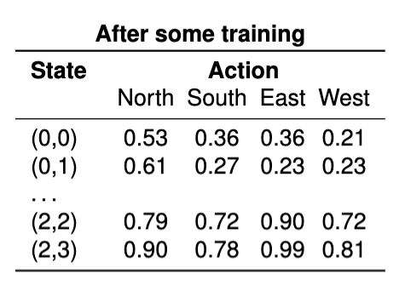
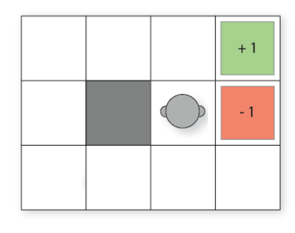
Q-Learning
Notes:
Q-Table is just a fancy name for a simple lookup table where we calculate the maximum expected future rewards for action at each state. Basically, this table will guide us to the best action at each state.

Slide 8
Why Reinforcement Learning?
Model-based Method
Last deceptive point (LDP)
A formula to calculate an optimal LDP
Require reasoning about the model structure
Model-free method-RL
Only rely on real samples from the environment
Example: Ambiguity Model
maximise the entropy from the observer’s point of view
Problem: Require mutiple Q-Tables when dealing with multiple rewards
Notes:
There are two types of method, the on is model-based method
Usually this kind of method require a way to calculate an optimal last deceptive point. The last deceptive point means :given a path , its last deceptive point LDP is a node π , which is itself deceptive whereas all (if any) subsequent nodes are truthful.This method
However, this method Require reasoning about the model structure to inform the dissimulation!
the other is model free based
They rely on real samples from the environment and never use generated predictions of next state and next reward to alter behaviour (although they might sample from experience memory, which is close to being a model).

Slide 9
Deceptive Reinforcement Learning
Deceptive path planning
Deceptive step
Last deceptive point
Evaluation
Extent
density
magnitude
Notes:
Peta Masters and Sebastian Sardina state the deceptive reinforcement learning problem in the round.
LDP tells us the extent of the deception; the number of truthful steps determines density; and the degree of simulation or dissimulation per step gives us its magnitude

Slide 10
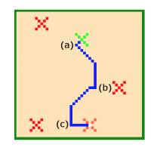
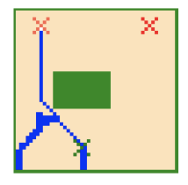
Previous Work
Irrational Model
Ambiguity Model
Notes:
Yue Yang∗ , Zhengshang Liu∗ , Peta Masters , Tim Miller propose two models to realice deceptive reinforcement learning. The one ambiguity model, the agent behaves ambiguously by selecting actions that have high Q-values not only for the real reward function but also for multiple bogus reward functions. As the trajectory progresses, fewer reward functions remain sensible, so these are pruned from consideration. Eventually, the policy selects actions only optimal for the true reward function. In this irrationality model, the deceptive Q-value of an action is a weighted sum of its optimal Q-value and a irrationality measure. The higher the weight on the optimal Q-value, the less deceptive the behaviour.

Slide 11
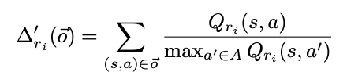
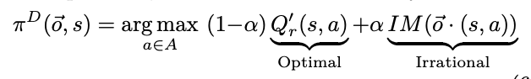
Previous Work
Irrational Model
Ambiguity Model
Both need to interact with multiple rewards with multiple Q-Table!
Notes:
Yue Yang∗ , Zhengshang Liu∗ , Peta Masters , Tim Miller

